Slide 1
A day in the life of Hadoop Administrator!

Slide 2
Agenda
At the end of this webinar we will Know about:
The daily tasks a Hadoop Admin do
Cluster Monitor tools
How Fault tolerance is maintained in cluster
Demo on Hadoop High Availability
Demo on YARN High Availability

Slide 3

Coming to office

Slide 4
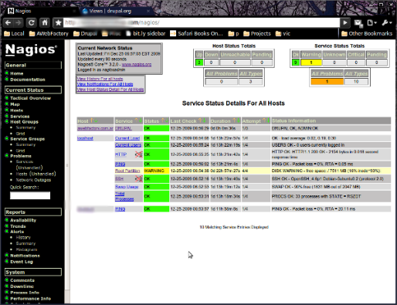
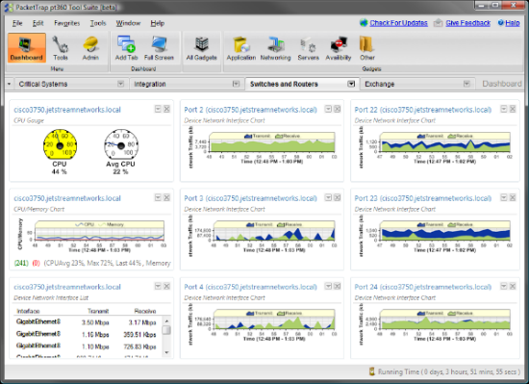

Cluster Monitoring
First thing on morning checking the monitor console (cloudera manager,Nagios,ganglia etc …) and the
jobtracker UI.

Slide 5




Few Cluster Monitoring Tools

Slide 6

Cluster Plan
Planning the day and reviewing past task in a meeting

Slide 7
Cluster Plan
Typical slave node hardware configurations
Midline configuration (all around, deep storage, 1 Gb Ethernet)
CPU | 2 × 6 core 2.9 Ghz/15 MB cache
Memory | 64 GB DDR3-1600 ECC
Disk controller | SAS 6 Gb/s
Disks | 12 × 3 TB LFF SATA II 7200 RPM
Network controller | 2 × 1 Gb Ethernet
Notes | CPU features such as Intel’s Hyper-Threading and QPI are desirable. Allocate memory to take advantage of triple- or quad-channel memory configurations.

Slide 8
Cluster Plan
High end configuration (high memory, spindle dense, 10 Gb Ethernet)
High end configuration (high memory, spindle dense, 10 Gb Ethernet)
CPU | 2 × 6 core 2.9 Ghz/15 MB cache
Memory | 96 GB DDR3-1600 ECC
Disk controller | 2 × SAS 6 Gb/s
Disks | 24 × 1 TB SFF Nearline/MDL SAS 7200 RPM
Network controller | 1 × 10 Gb Ethernet
Notes | Same as the midline configuration

Slide 9

Execute Few Regular Utility Tasks
Developing and running files merger so that the small files and directories our data suppliers create would become bigger and fewer.

Slide 10

Backup And Recovery Task

Slide 11
Demo
Achieving Hadoop High Availability

Slide 12




Job Scheduling And Configuration
Keep the farm working – we build monitoring, managing resources between our users and our tools, tuning configurations for the farm stack, for mapreduce, spark jobs and for the servers of course.

Slide 13



Analyzing Failed Tasks
Analyzing too heavy or failed jobs and Fixing problems

Slide 14
Demo
Achieving YARN High Availability

Slide 15





Evaluating New Host Requests
Collecting and Defining requirements for new hosts

Slide 16




Updates And Upgrades
Upgrading and updating the farm from time to time

Slide 17



Try And Finalize New Solutions
Trying to test and benchmark new projects.

Slide 18



Be In Touch With New Configuration Tools
Set a configuration management tool for our test and production environments

Slide 19



Execute Few DWH Responsibilities
Developing an easy infrastructure to insert data to the cluster and into hive and hbase

Slide 20



Assisting Hadoop Developers
Daily support for developers who use the hadoop stack

Slide 21


Checking Resources Usage And Users Permissions
Managing users, permissions , quotas, etc

Slide 22
Demo
Demo on User permission and Quota

Slide 23


Trubleshooting

Slide 24
Common Error Messages
NameNode startup fails
Exception when initializing the filesystem
Could not obtain block blk_-4157273618194597760_1160 from any node
Could only be replicated to 0 nodes instead of 1
Server not available
Could not get block locations. Aborting...

Slide 26
Survey

